Slide 1
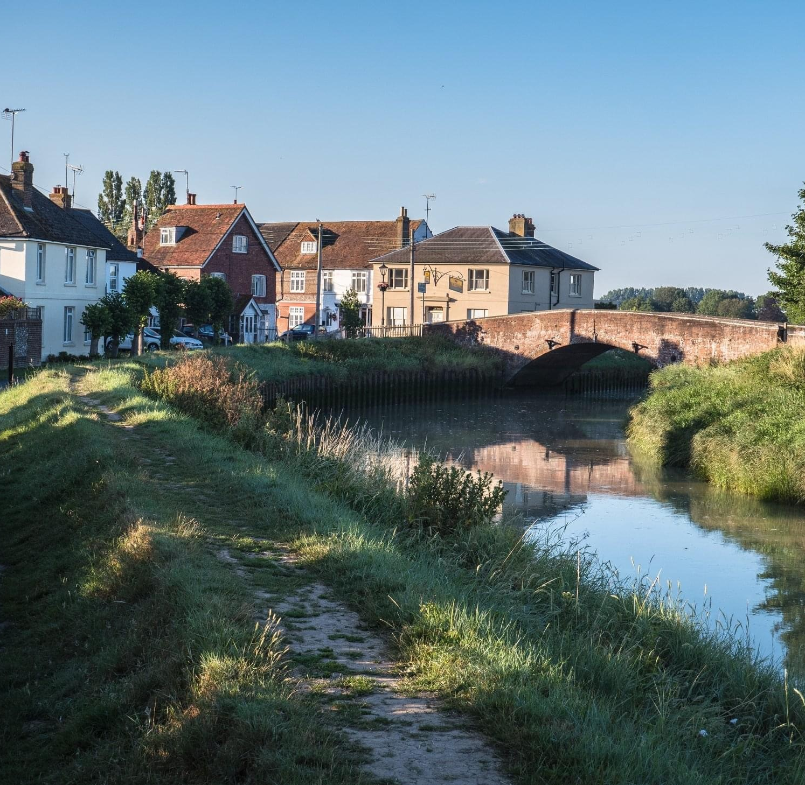
Upper Beeding Parish Council
Business Plan 2021-2026

Slide 2
Upper Beeding Parish Council five year roadmap timeline 2021-2026
Newsletters
Skatepark working group
Volunteers Working Group
Tree Planting
Councillor Surgeries
Chairman’s Annual Review
Neighbourhood Wardens
Dementia Friendly PC
Rewilding verges project
2021 - - - - - - - - - - - - - - - - - - - - - - - - - - - - - - - - - - - - - - - - - - - - - - - - - - - - - - - 2022- - - - - - - - - - - - - - - - - - - - - -
NP Referendum
Community Led Highways Scheme
Events
Newsletters
Accessibility Survey
Youth Club
Tree Planting
Councillor Surgeries

Slide 3
Upper Beeding Parish Council five year roadmap timeline 2021-2026
Community Composting
Local Recycling Policy
Chairman’s Annual Review
Riverside Walk
Newsletters
Real Time Bus Information Signs
Electric Car Charging
Volunteers
Skatepark
- - - - - - - - - - - - - - - - - - - - - 2023 - - - - - - - - - - - - - - - - - - - - - - - - - - - - - - - - - - - - - - - - - - - - - - - - - - - -2026 - - - -
Councillor Surgeries
Play Areas
Parish Council Elections
Chairman’s Annual Review
Implement NP Policies
Tree Planting
Southdowns Link
Events

Slide 4
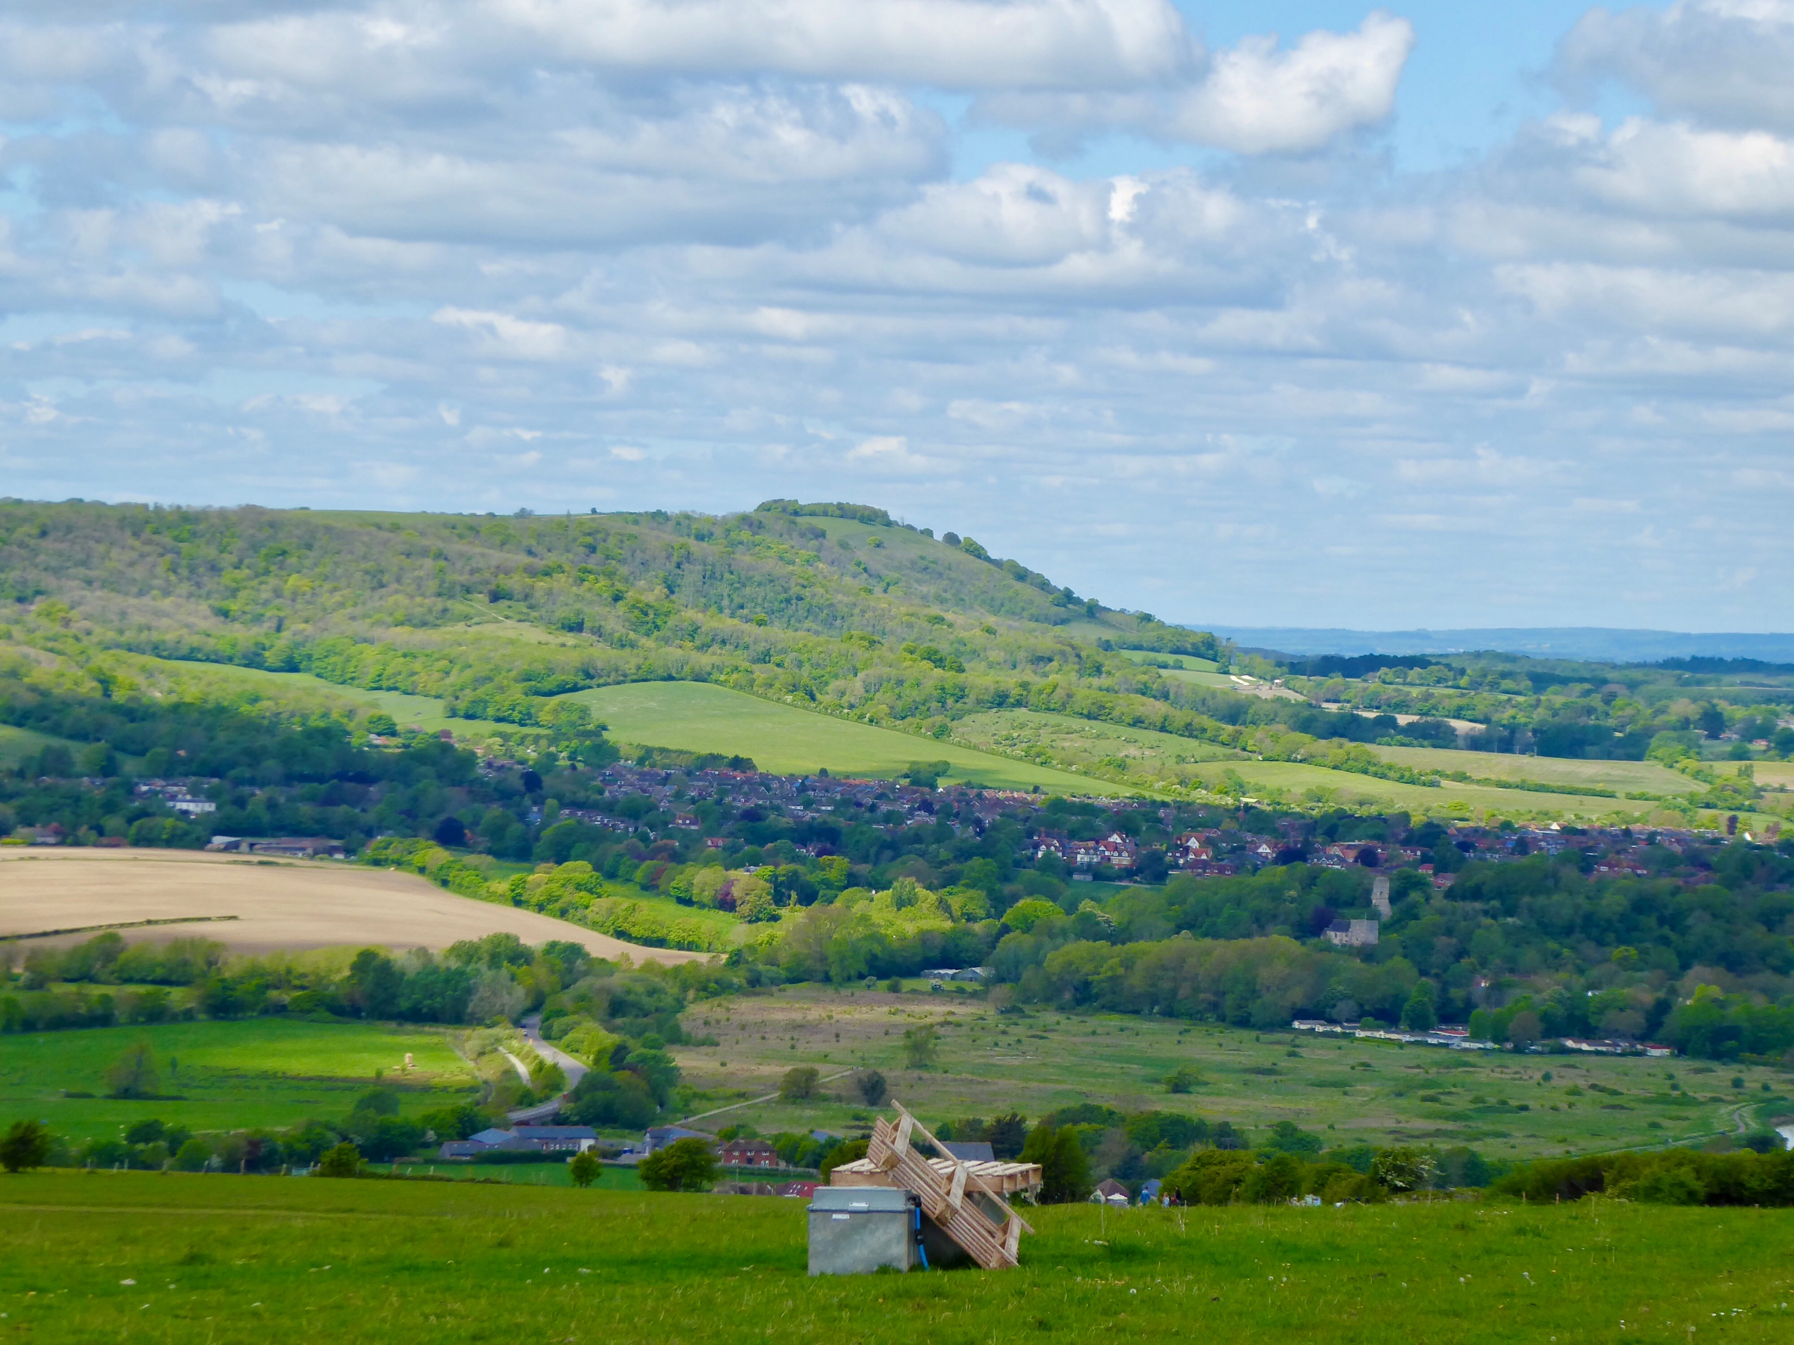
Community
Short Term Objectives
Improve communication.
Become a Dementia Friendly Parish Council.
Develop Hyde Street Green to be more accessible and useable for the whole community.
Medium/Long Term Objectives
Work collaboratively with village organisations and residents.
Support the Community Speedwatch Scheme
Evaluate and develop the Neighbourhood Warden Scheme.
Develop the Youth Club.
Organise Community Events e.g. Christmas Lights.

Slide 5
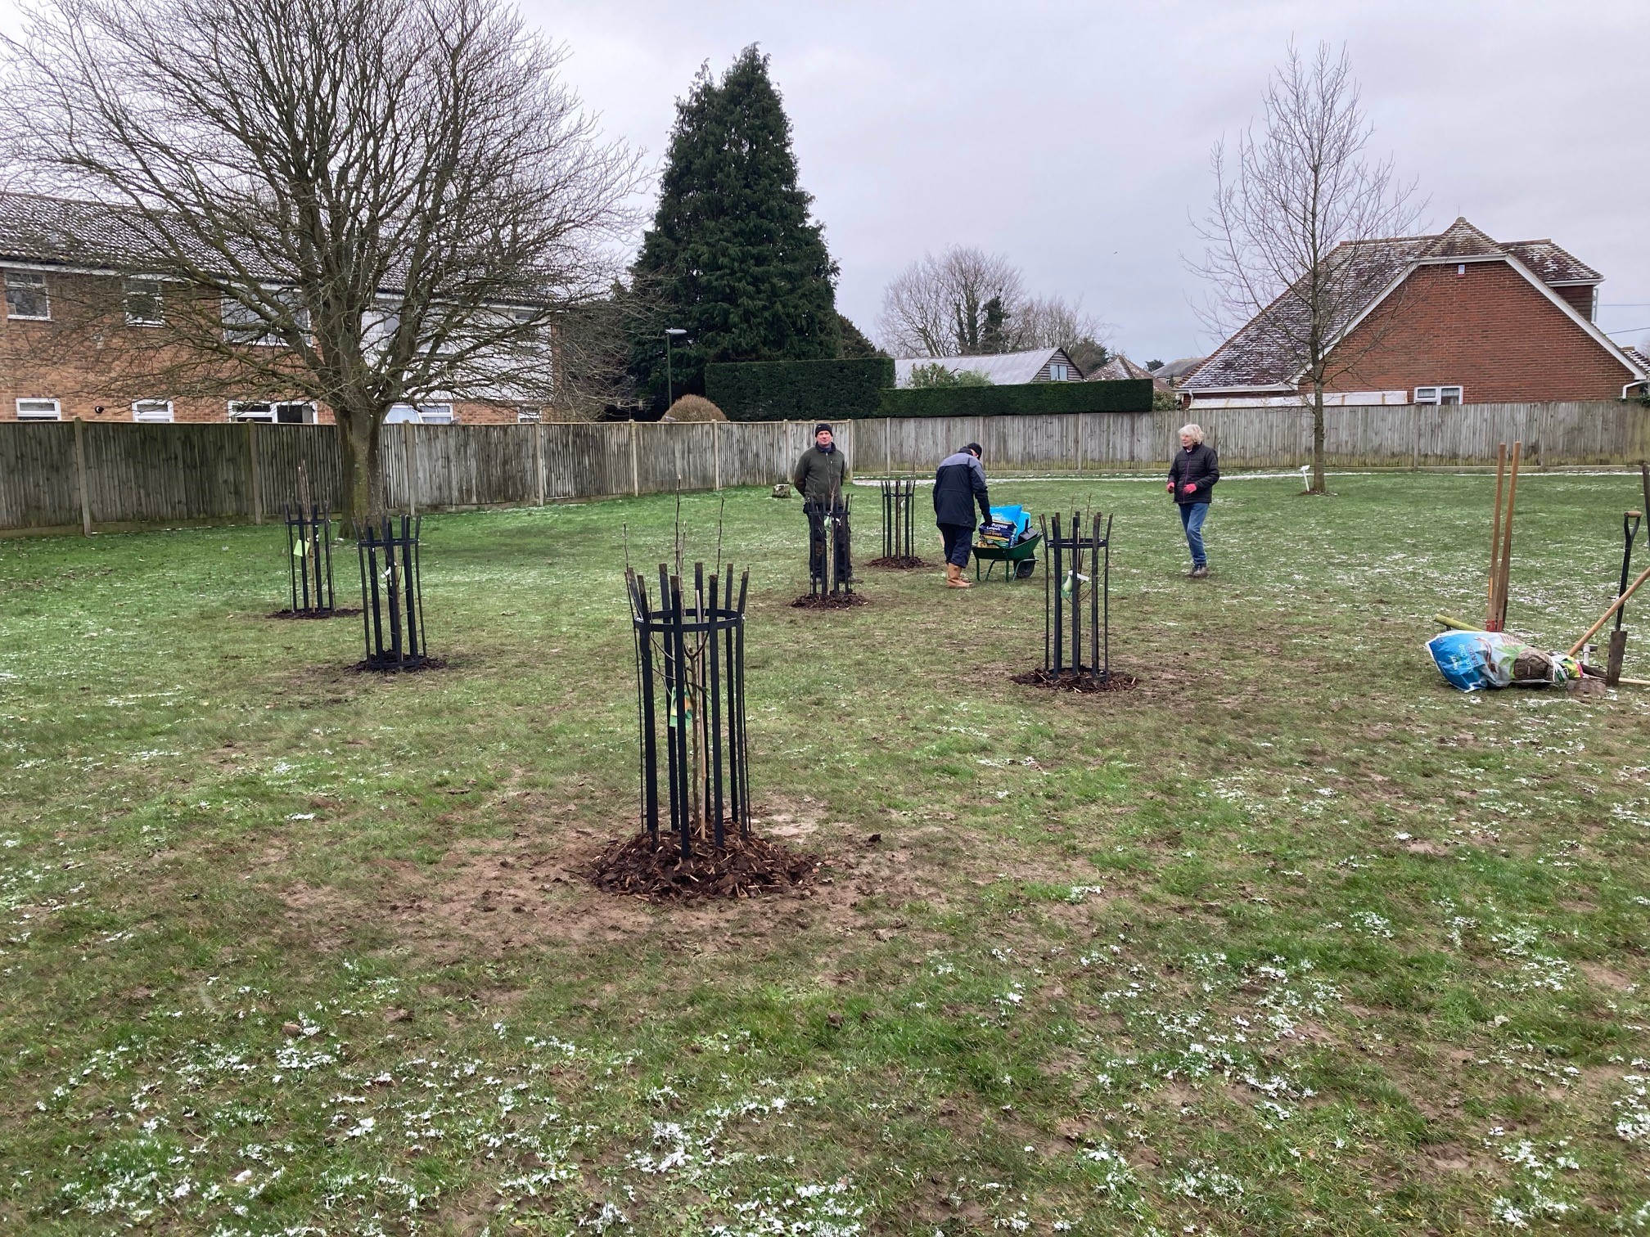
Environmental
Short Term Objectives
Register with WSCC to be included in pilot for re-wilding verges.
Change Sports Hall electricity supplier.
Develop Community Orchard.
Continue with tree planting programme.
Recruit volunteers and establish a sustainable programme.
Long Term Objectives
Develop Community Orchard.
Investigate Community Composting.
Investigate Electric Car Charging Points.

Slide 6
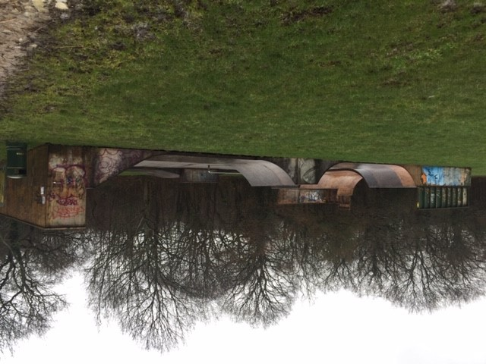
Facilities
Short Term Objectives
Organise a working party to establish the long term aims of the Skatepark.
Continue to maintain and enhance play areas and open spaces
Instigate a Community Led Highways Scheme for a new footpath from Manor Road to Henfield Road.
Complete an audit and suggest programme of works to improve accessibility throughout the village.
Promote 20mph zones
Undertake a streetlight review
Long Term Objectives
Riverside Walk
Sports Hall improvements
Work with Henfield PC to improve access to the Southdowns Link at Small Dole

Slide 7
Planning
Short Term Objectives
Finalise the Neighbourhood Plan at Referendum as soon as possible.
Continue to respond in a timely manner to planning application consultations.
Long Term Objectives
Work in collaboration with HDC and SDNP to ensure NP policies are adhered to.
Work with Henfield Parish Council concerning any new development in Small Dole

